Slide 1
Development of an Enterprise2Map Javascript Library
Team: Mentor:
Asif Altaf Niklas Peterson
Awais Bajwa
Rahul Jyoti Nath
Group F, Enterprise Information System,19th Oct., 2016
Notes:
‹#›

Slide 2
Introduction
Maps Enterprise Data on a Map.
Converts Turtle Data to a Map representable GeoJSON Format.
Filtering of Data is possible.

Slide 3
Requirements
Input Data should be in Turtle Format in a specific format.
Angular JS.
Leaflet.
Apache Jena Fueski.

Slide 4
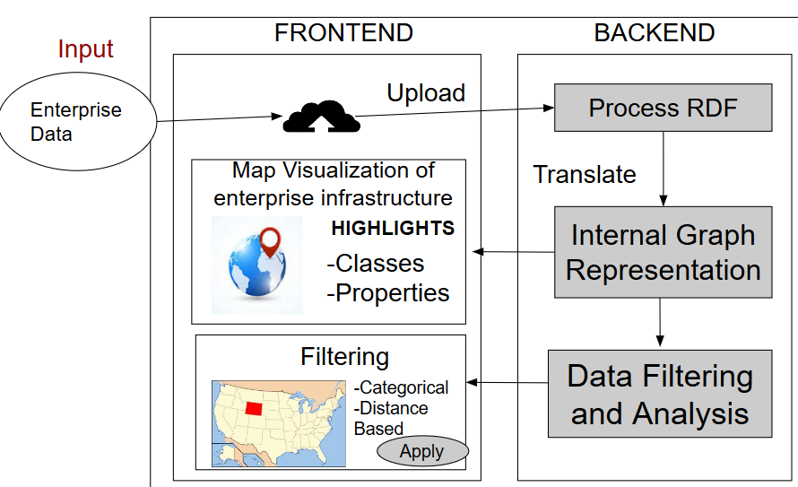
Architecture

Slide 5
Results
RDF -> GeoJson
Takes RDF data in Turtle Format as Input and converts into GeoJson data.

Slide 6
Results
GeoJson -> Map
GeoJson Data is plotted on the Map with the underlying features along with it.

Slide 7
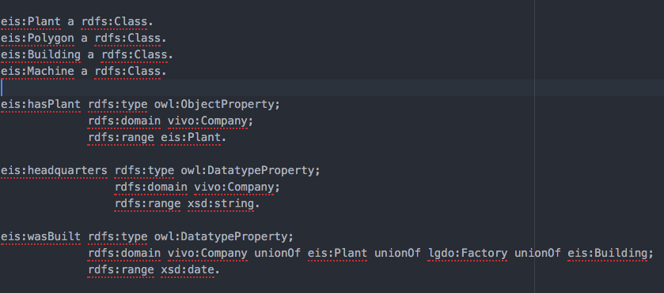
Ontology

Slide 8
Input Data
The Input Data has to comply with our Ontology.

Slide 9
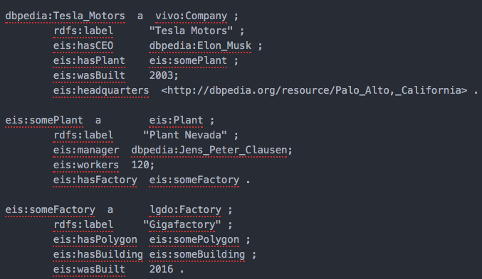
Input Data - II

Slide 10
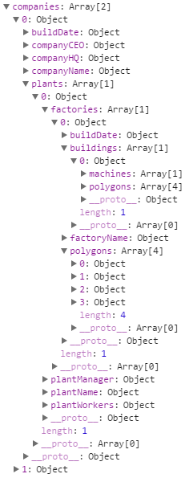
Converted GeoJSON Data
The Input Data in Turtle Format is converted to JavaScript Object containing array of enterprises as it is shown in the figure.

Slide 11
Plotting on Map
The Converted GeoJSON Data is then plotted on Map using LeafletJs.

Slide 12
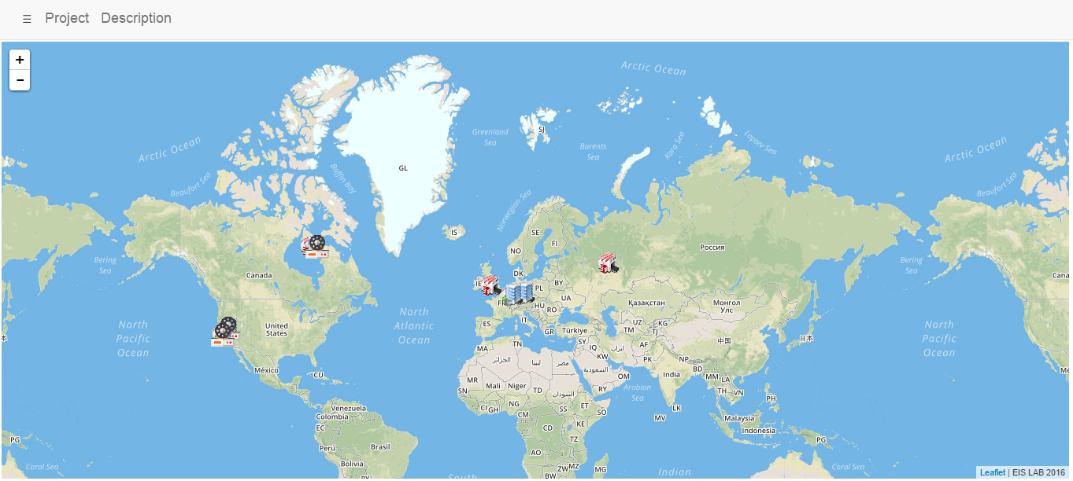
Demo

Slide 13
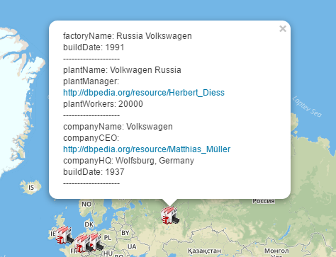
Pop-up

Slide 14
Filtering Capability
By Features:-
Company, Factory, Building, Machine, Others.
By Country.

Slide 15
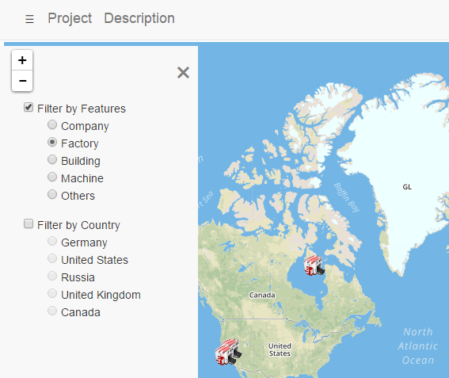
Filtering Capability - II

Slide 16
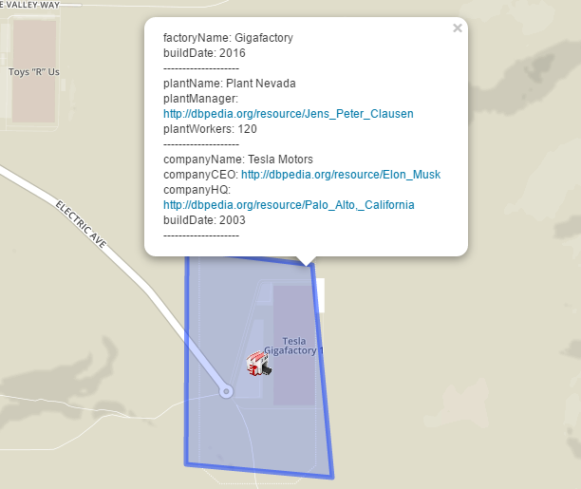
Detailed Geometric Depth on Map

Slide 17
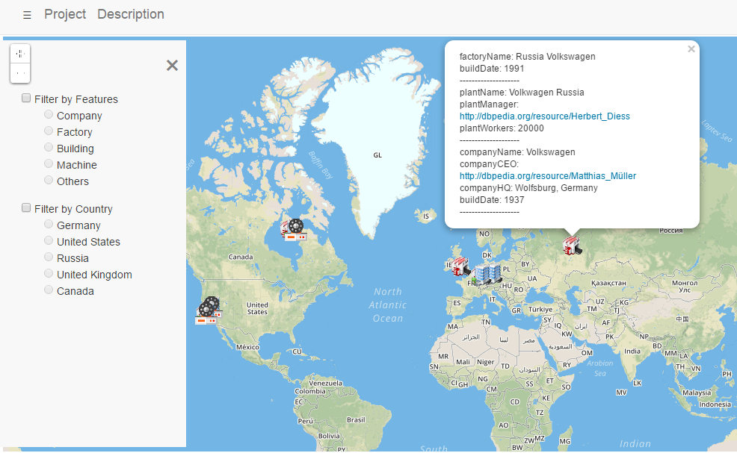
Complete View

Slide 18
Future Work
Ontology can be expanded.
Filtering can be improved by adding filtering capability on more features.
Data Parsing can be generalised further.

Slide 19

Notes:
‹#›

